Slide 1

An Introduction to R
Derek Beaton

Slide 2
Big outline
Part 1: Introduction
Part 2: Set up
Part 3: Syntax and basic usage
Part 4: Simple (but important) examples

Slide 3
Part 1: Introduction
Cover three topics:
A bit of background
What is R?
Why use R?

Slide 4
Part 1: Introduction
Cover three topics:
A bit of background
What is R?
Why use R?

Slide 5
A bit of background
Created in 1992 by Gentleman & Ihaka:
“[we] considered the problem of obtaining decent statistical software for our undergraduate Macintosh lab. After considering the options, we decided that the most satisfactory alternative was to write our own. […] Finally we added some syntactic sugar to make it look somewhat like S. We call the result “R”.”
See also Ihaka, R. (1998). R: Past and future history. Computing Science and Statistics, 392-396.
http://adolfoalvarez.cl/the-free-open-and-proprietary-flavors-of-r/

Slide 6
A bit of background
R comes from S
S now commercialized as S+
R also commercialized (we’ll get to that)
R Foundation:
Not-for-profit, guide R’s future
Supports R projects, conferences, community, and software
Has a journal: https://journal.r-project.org/
https://www.r-project.org/about.html

Slide 7
A bit of background
R comes from S
S now commercialized as S+
R also commercialized (we’ll get to that)
R Foundation:
Not-for-profit, guide R’s future
Supports R projects, conferences, community, and software
Has a journal: https://journal.r-project.org/
https://www.r-project.org/about.html

Slide 8
A bit of background
R Core Team:
International collaboration
Develop, distribute, and maintain
Great thing:
Written by statisticians for statisticians
Not always a great thing:
Written by statisticians for statisticians
E.g., experimental design & Type 1 vs. Type 3 sums of squares

Slide 9
A bit of background
R Core Team:
International collaboration
Develop, distribute, and maintain
Great thing:
Written by statisticians for statisticians
Not always a great thing:
Written by statisticians for statisticians
E.g., experimental design & Type 1 vs. Type 3 sums of squares

Slide 10
A bit of background
R is free
Free is a good thing!
Long time myth:
Money = Quality

Slide 11
A bit of background
Gratis (as in beer) and Libre (as in speech)No cost
No restrictions
You don’t pay and you can do anything you want with it

Slide 12
A bit of background
Gratis (as in beer) and Libre (as in speech)No cost
No restrictions
You don’t pay and you can do anything you want with it

Slide 13
A bit of background
Gratis (as in beer) and Libre (as in speech)No cost
No restrictions
You don’t pay and you can do anything you want with it

Slide 14
A bit of background
Gratis (as in beer) and Libre (as in speech)
No cost
No restrictions
You don’t pay and you can do anything you want with it

Slide 15
A bit of background
Gratis (as in beer) and Libre (as in speech)
No cost
No restrictions
You don’t pay and you can do anything you want with it even sell it!

Slide 16
A bit of background
Current state of R
First stable release: 2000-02-29
Now: Version 3.3.3 (Another Canoe; 2017-03-06)
Updates: ~6 months
Exploding in usage
If you’re not using R you will be left behind!
R is taking over
Because of > 10k packages
https://en.wikipedia.org/wiki/R_(programming_language)#Milestones

Slide 17
A bit of background
Current state of R
First stable release: 2000-02-29
Now: Version 3.3.3 (Another Canoe; 2017-03-06)
Updates: ~6 months
Exploding in usage
If you’re not using R you will be left behind!
R is taking over
Because of > 10k packages

Slide 18
Is R taking over?

Slide 19
R is taking over!

Slide 20
R is taking over!
NY Times Article
http://www.nytimes.com/2009/01/07/technology/business-computing/07program.html

Slide 21
R is taking over
In part because it’s:
Free
Flexible
But you can pay if you’d like
For us: there is (almost) no reason to pay

Slide 22
Pay for pass through access?
Almost all major statistical environments interface with R now:
SPSS (https://www.ibm.com/developerworks/library/ba-call-r-spss/)
SAS (https://www.ibm.com/developerworks/library/ba-call-r-spss/)
Excel (https://www.r-bloggers.com/a-million-ways-to-connect-r-and-excel/)
Et al., (http://r4stats.com/articles/calling-r/)

Slide 23
So free you can sell it!
Yep, you can sell free (GPL) software!
Technically selling “support” or “features” for enterprise (not academia)
Oracle R
Revolution R (now Microsoft)
RStudio

Slide 24
Free versions for us!
Yep, you can sell free (GPL) software!
Technically selling “support” or “features” for enterprise (not academia)
Oracle R
Revolution R (now Microsoft)
RStudio
Notes:
What do you get if you pay? Especially with Rstudio?

Slide 25
For us
Let’s stick with the free versions
It’s what almost all R users have
It’s in the spirit of R & R Foundation
Free, open source software built around and by communities

Slide 26
Part 1: Introduction
Cover three topics:
A bit of background
What is R?
Why use R?

Slide 27
What is R?
R is for stats and general purpose programming
R is a language
Turing complete – can do anything any other language can do
R is an environment
With prepackaged software, ready to get the job done

Slide 28
What is R?
R: The environment
Environment is an interface
Interface to the language
R: Has many interfaces

Slide 29
What is R?

Slide 30
What is R?
A bit ugly

Slide 31
What is R?
Console based
Type commands in
No point-and-click
But…

Slide 32
What is R?
R Commander

Slide 33
What is R?
There are environments to suit many needs
SPSS-like
Matlab-like

Slide 34
De
Deducer

Slide 35
What is R?
There are environments to suit many needs
SPSS-like
Matlab-like

Slide 36
What is R?
There are environments to suit many needs
SPSS-like
Matlab-like

Slide 37
R Studio
Great environment

Slide 38
CONSOLE

Slide 39
FILES, PLOTS, HELP

Slide 40
ENVIRONMENT, VARIABLES, VERSION CONTROL

Slide 41
CODE

Slide 42
DATA VIEWER

Slide 43
R Studio
So many bells & whistles
Integration with version control
E.g., Git or SVN
Package & documentation generation

Slide 44
R Studio
Also like a mini R Foundation
Products
Packages
Conferences
Learning, training, and resources

Slide 47
R Studio
Proponents and supporters of reproduciblity
R Markdown:
“Save and execute code
Generate high quality reports that can be shared”

Slide 48
What is R?
R: The language
We’ll go fast here!

Slide 49
What is R?
R: The language
We’re going to dive in soon anyways!

Slide 50
What is R?
R: The language
Based on S

Slide 51
What is R?
For the nerds:
A “functional” language
For the rest of us:
A language designed to speak stats

Slide 52
What is R?
At first: a bit tricky to get used to

Slide 53
What is R?
If you know Matlab or S
Not so bad
If you don’t
An intimidating and steep learning curve
Universal agreement: Worth it.

Slide 54
What is R?

Slide 55
Your R question is not unique!

Slide 56
What is R?
If you know Matlab or S
Not so bad
If you don’t
An intimidating and steep learning curve
Universal agreement: Worth it.

Slide 57
Worth it
“[…] ephemeral. […], we tend to run one prescribed procedure for each type of analysis. […] We can carefully set up the run with all the parameters and options that we need. [then] We then sift through this output pulling out what we need and discarding the rest.”
“R is different. […] the process is highly interactive. You run a command (say fit a model), take the results and process it through another command (say a set of diagnostic plots), take those results and process it through another command (say cross-validation), etc. It is not an easy mental shift for many of us to make. […]”
“In that in the end, however, I believe that you will feel much more intimately in touch with your data and in control of your work.”
http://www.statmethods.net/about/learningcurve.html

Slide 58
What is R?
It’s more than a tool
It’s a community
Actually: Many communities!

Slide 59
R Communities
Two types:
Help & resources
Package development & distribution
Sometimes one and the same

Slide 60
R Communities
Two types:
Help & resources
Package development & distribution
Sometimes one and the same

Slide 61
R: Help!
My first: http://www.statmethods.net/
Online forums (SE, CV, r-lists)
Find experts (e.g., next speaker!)
http://www.personality-project.org/r/r.guide.html
They’re all around you!

Slide 62
R: Help!
Does your library have SpringerLink?
You can get all of their R books:
For free (in PDF)
For minimal cost (printed and sent to you)
“Vignettes”
How-tos on CRAN for packages

Slide 63
R: Help!
Does your library have SpringerLink?
You can get all of their R books:
For free (in PDF)
For minimal cost (printed and sent to you)
“Vignettes”
How-tos on CRAN for packages

Slide 64
Vignettes
Step-by-step instruction guides

Slide 67
R Communities
Two types:
Help & resources
Package development & distribution
Sometimes one and the same

Slide 68
What are packages?
Bundles of code
Made by someone (or many people)
For everyone to use
If you can think of a stats problem: it has at least one package on R
http://r-pkgs.had.co.nz/

Slide 69
What are packages?
“Packages are the fundamental units of reproducible R code. They include reusable R functions, the documentation that describes how to use them, and sample data.” – Hadley Wickham
http://r-pkgs.had.co.nz/

Slide 70
What are packages?
Bundles of code
Made by someone (or many people)
For everyone to use
If you can think of a stats problem: it has at least one package on R
http://r-pkgs.had.co.nz/

Slide 71
What is R?
CRAN (https://cran.r-project.org/)
Primary place to get packages
But many others
Github
R-forge
Even specialized
BioConductor (Bioinformatics/Biostatistics)
NeuroConductor (mostly neuroimaging)

Slide 72
How to find packages?
CRAN
https://cran.r-project.org/web/packages/
It’s Crantastic!
http://www.crantastic.org/
RPACKAGES
https://www.rpackages.io/

Slide 73
How to find packages?
CRAN
https://cran.r-project.org/web/packages/
It’s Crantastic!
http://www.crantastic.org/
RPACKAGES
https://www.rpackages.io/

Slide 74
Stats and Ranks
Out of >10k packages

Slide 75
psych vs. ExPosition
Notes:
59 out of > 10k!

Slide 76
psych vs. ExPosition
Notes:
59 out of > 10k!
Dropped to 63!

Slide 77
psych vs. ExPosition
Notes:
At least it’s in the top 26%!
I’ve actually dropped to ~3500

Slide 78
Part 1: Introduction
Cover three topics:
A bit of background
What is R?
Why use R?

Slide 79
Why use R?
Extremely well supported
Very popular
Organic community
Free & flexible
But if you’re not convinced yet…

Slide 80
Why use R?
The graphics
Arguably the best graphics utilities for stats & programming environments
Built into base R
As packages

Slide 81
Why use R
Base R: interaction.plot()
ANOVA-based visualizer

Slide 82
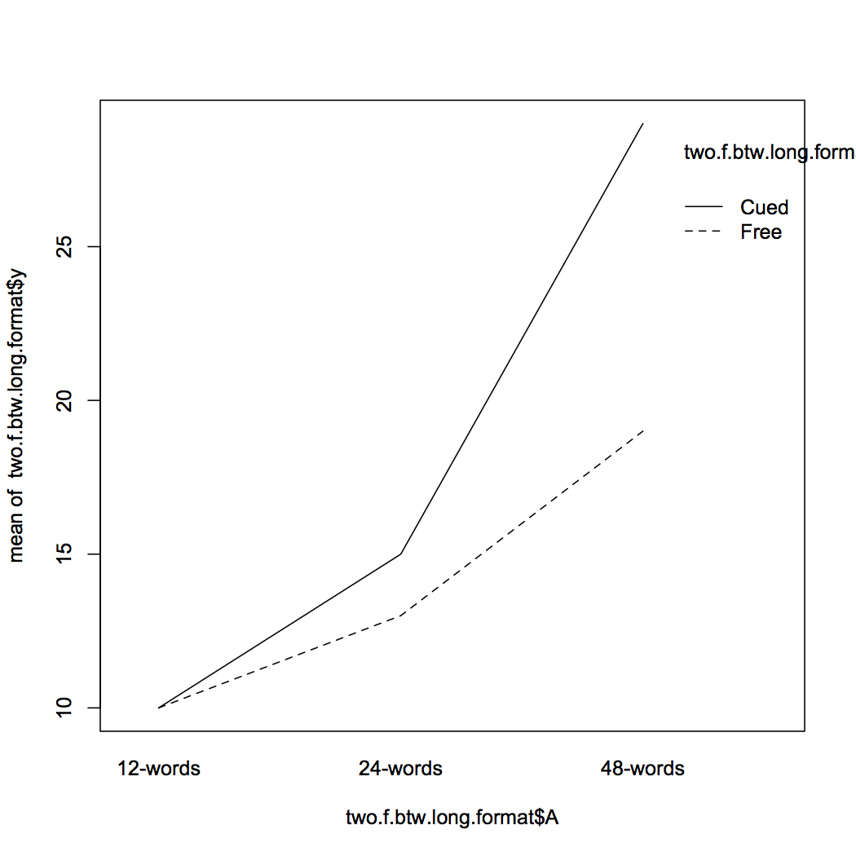
Notes:
The default visualization. It’s simple & crisp which is great, but with just a tweak or two

Slide 83
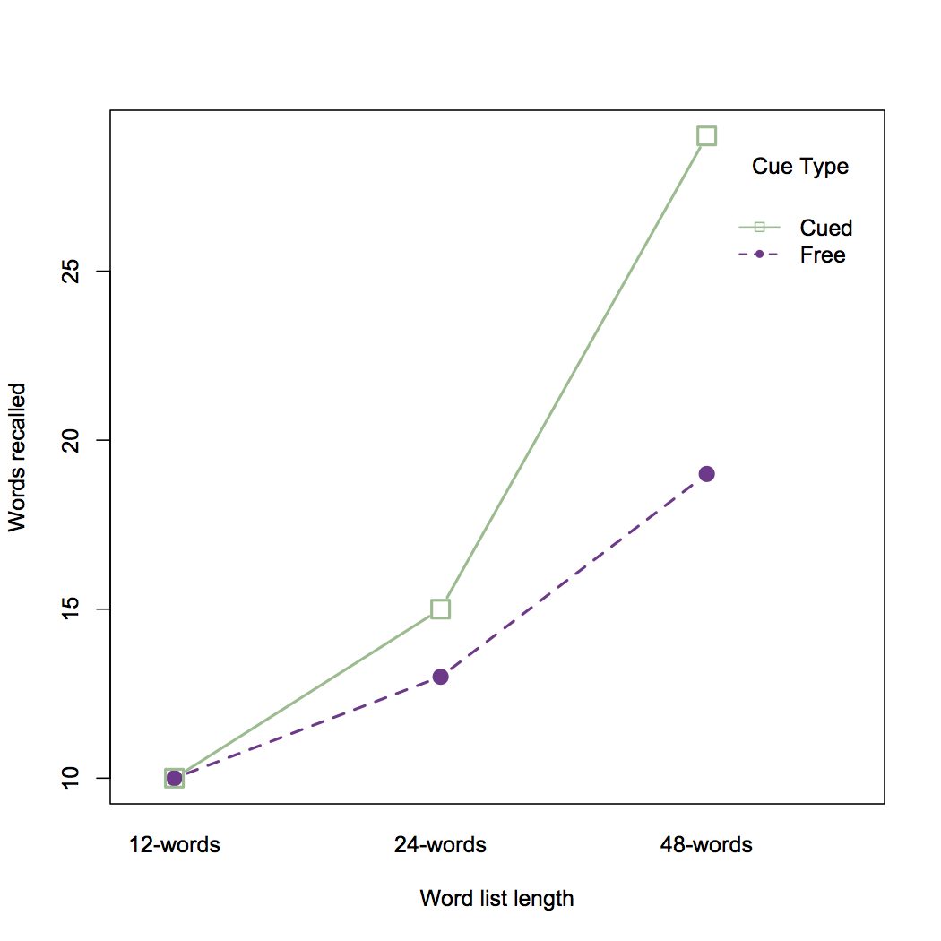
Notes:
The default visualization. It’s simple & crisp which is great, but with just a tweak or two

Slide 84
Why use R?
ggplot2: grammar of graphics
Massively popular

Slide 85
Notes:
#2 package!

Slide 86
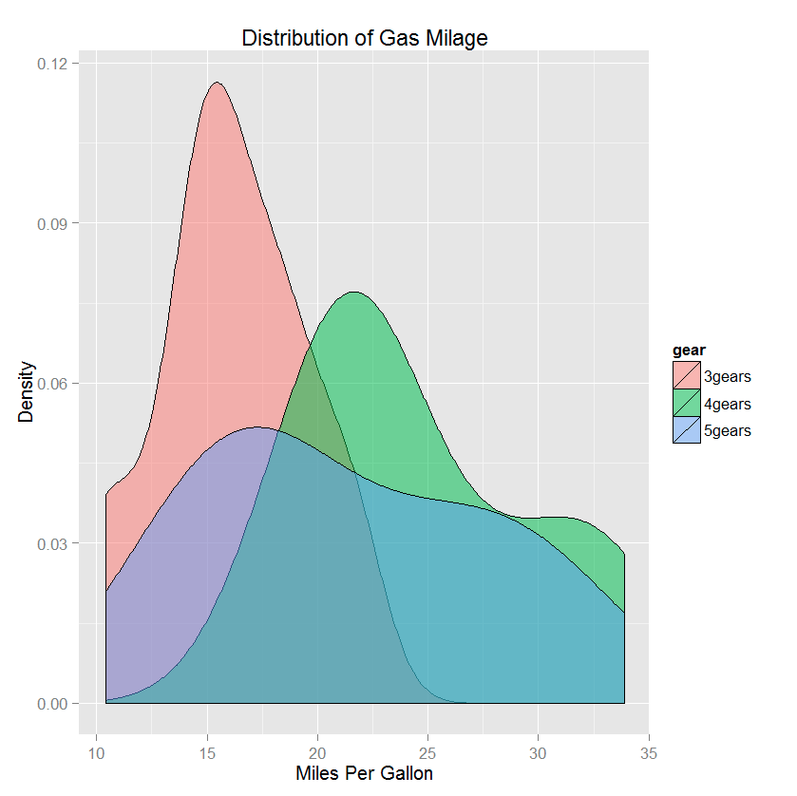
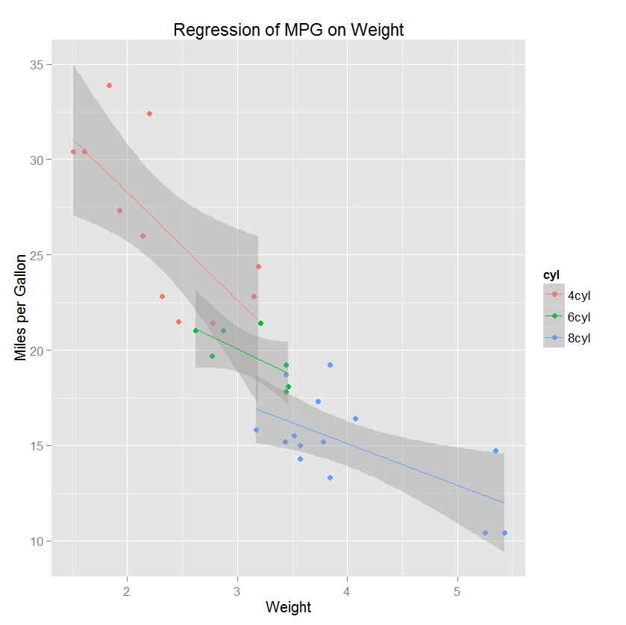
Notes:
#2 package!

Slide 87
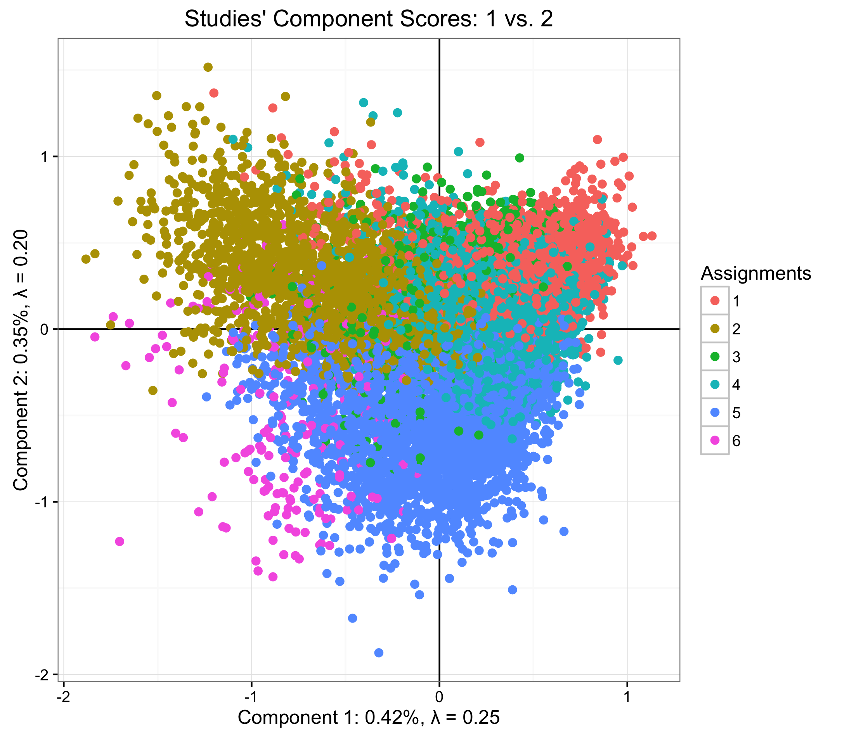
Notes:
#2 package!

Slide 88
aRt work
R Graph Gallery
http://www.r-graph-gallery.com/
Rtist: Gaston Sanchez
http://gastonsanchez.com/Rtist/

Slide 89
Notes:
#2 package!

Slide 90
aRt work
R Graph Gallery
http://www.r-graph-gallery.com/
Rtist: Gaston Sanchez
http://gastonsanchez.com/Rtist/

Slide 91

Notes:
#2 package!

Slide 92
Why use R?
Last two reasons

Slide 93
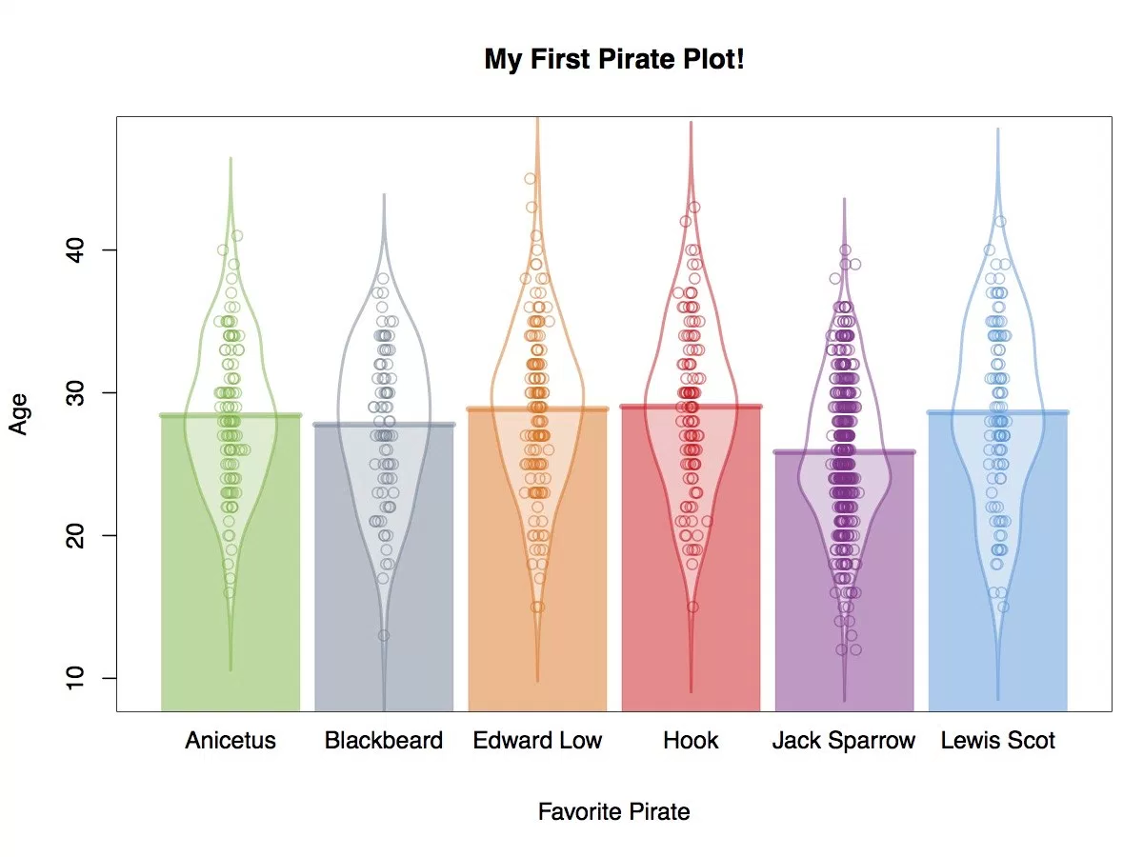
Pirate Plots
http://nathanieldphillips.com/2016/04/pirateplot-2-0-the-rdi-plotting-choice-of-r-pirates/

Slide 94
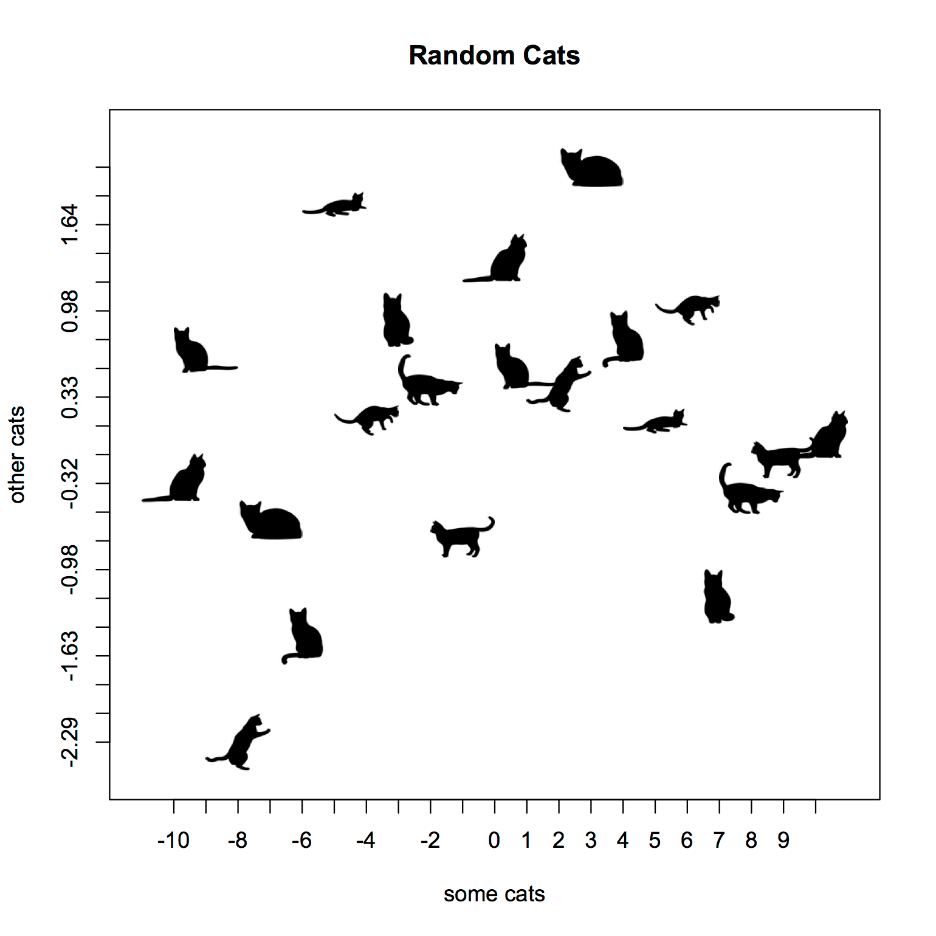
https://github.com/Gibbsdavidl/CatterPlots
Notes:
If you weren’t sold by now, and the catterplots don’t sell you then there is no hope!

Slide 95
Part 1: Introduction
Covered three topics:
A bit of background
What is R?
Why use R?

Slide 96
Big outline
Part 1: Introduction
Part 2: Set up
Part 3: Syntax and basic usage
Part 4: Simple (but important) examples

Slide 97
Download R
CRAN: Comprehensive R Archive Network
R Core/Foundation dedicated website
To download: https://cran.r-project.org/
Pick your OS:
Notes:
Comprehensive R Archive Network

Slide 98
Download R
CRAN: Comprehensive R Archive Network
R Core/Foundation dedicated website
To download: https://cran.r-project.org/
Pick your OS:
Notes:
Comprehensive R Archive Network

Slide 99
Part 2: Set up
Three questions:
Do you have R installed?
Do you have ‘psych’ installed?
Do you have ‘lavaan’ installed?

Slide 100
If ‘No’ to any
We have some helpers & thumb drives!
If you can’t follow along, we’ll make material available for you:
github.com/derekbeaton/Workshops/SAMR2017
http://www.personality-project.org/r/
Notes:
Maybe a small break here.

Slide 102
Information about R

Slide 103
Type things here

Slide 104
Try this

Slide 106
Package installation
> install.packages(c(‘psych’,’lavaan’),dependencies=T)

Slide 108
Big outline
Part 1: Introduction
Part 2: Set up
Part 3: Syntax and basic usage
Part 4: Simple (but important) examples

Slide 109
Part 3: Syntax & usage
Cover two topics:
R syntax (code)
Absolute basics

Slide 110
First and foremost
R is a big, (very) fancy calculator
Some examples

Slide 113
Can only take you so far

Slide 114
Three concepts
Variables
Functions
Scripts

Slide 115
Three concepts
Variables
Functions
Scripts

Slide 116
Variables
Called so because they can change
But they only change when you make them change

Slide 117
Variables
> save.this <- from.that

Slide 118
Variables
> save.this <- from.that

Slide 119
Variables
> save.this <- from.that

Slide 120
Variables
> save.this <- from.that

Slide 121
Variables
> save.this <- from.that

Slide 122
Variables
> save.this = from.that

Slide 123
Variables
> save.this = from.that

Slide 124
Variables
> save.this <- from.that

Slide 125
Variables
Rules:
(mostly) Alphanumeric
Cannot start with numbers
Cannot have spaces
. and _ are OK
E.g.,
> my.var or > my_var or > my_Var.1

Slide 126
Variables
Guidelines:
Give them meaning
Make sure someone else understands the words
E.g.,
my.var is not good
one.factor.anov.res is good

Slide 127
Beyond variables
Style guides
Google: https://google.github.io/styleguide/Rguide.xml
Hadley Wickham: http://adv-r.had.co.nz/Style.html
Recent commentary:
Johnson PE (2016). R Style An Rchaeological Commentary. https://cran.r-project.org/web/packages/rockchalk/vignettes/Rstyle.pdf

Slide 128
Back to calculator

Slide 133
Three concepts
Variables
Functions
Scripts

Slide 134
We’ve seen one

Slide 137
Functions
The mathematical concept

Slide 138
Functions
y = f(x)

Slide 139
Stuff goes in
y = f(x)

Slide 140
Magic
y = f(x)

Slide 141
Save that magic!
y = f(x)

Slide 142
R does the same thing
Say f(x) is √x

Slide 143
f(x)
If x is 4
f(x) is 2

Slide 144
Functions
> sqrt(4)

Slide 145
Functions
> sqrt(4)
[1] 2

Slide 151
Functions
There are also non-mathematical functions
getwd(), setwd(), and friends
rm()

Slide 156
Notes:
A small note: a lot of functions in R do the same or similar things
Additionally, a lot of functions play many many many roles as we’ll see when we get to the function “summary”

Slide 157
Functions
There are also non-mathematical functions
getwd(), setwd(), and friends
rm()

Slide 163
Functions
Installed and install
installed.packages()
install.packages()

Slide 166
Notes:
Head returns first (or last) parts of some object. In this case a data table that lists packgaes and information about this packages.

Slide 167
Functions
Installed and install
installed.packages()
install.packages()

Slide 170
Help!
? – Help
?? – Helpless!

Slide 171
Help!
? – Help
?? – Helpless!

Slide 175
Help!
? – Help
?? – Helpless!

Slide 178
More useful functions

Slide 179
More useful functions
Data & distributions
Just a sample of these

Slide 181
Notes:
Wickham’s “fundamental units of R” – a lot of packages provide data for you.

Slide 183
Functions
Data & distributions
Just a sample of these

Slide 184
No more look up tables!
http://www.personality-project.org/
Notes:
STOLEN FROM WR

Slide 185
Some examples
Compute F By hand but no p-value
Poorly formed APA statement

Slide 187
F = 7.227
df1 = 3
df2 = 16
p = ?

Slide 191
Some examples
Compute F By hand but no p-value
Poorly formed APA statement

Slide 192
Bad APA statement
Sample size was 80 with 20 participants for each of the four conditions. We found the effect of recall to be significant p = .00235.

Slide 194
PubPeer & statcheck
statcheck – checks APA style statements for (in)correct stats
Currently in use at PubPeer

Slide 197
Three concepts
Variables
Functions
Scripts

Slide 198
Scripts
Just like they sound
Top-down list of instructions
To keep the instructions around and run then again
Or add to them

Slide 204
‘source’
source()
“sources” a script
Runs all instructions from top-to-bottom

Slide 208
Three concepts
Variables
Functions
Scripts

Slide 209
Big outline
Part 1: Introduction
Part 2: Set up
Part 3: Syntax and basic usage
Part 4: Simple (but important) examples

Slide 210
Five concepts
Describe and visualize data
Very simple stats
Loading packages
Getting data from outside of R
Some more stats

Slide 211
Five concepts
Describe and visualize data
Very simple stats
Loading packages
Getting data from outside of R
Some more stats

Slide 236
Five concepts
Describe and visualize data
Very simple stats
Loading packages
Getting data from outside of R
Some more stats

Slide 248
Five concepts
Describe and visualize data
Very simple stats
Loading packages
Getting data from outside of R
Some more stats

Slide 253
Five concepts
Describe and visualize data
Very simple stats
Loading packages
Getting data from outside of R
Some more stats

Slide 254
Getting data from outside
The usual suspects

Slide 255
Getting data from outside
> read.table()
> read.csv()

Slide 257
Something more useful
psych:::read.file

Slide 261
Summarize data
summary()

Slide 263
Better summary
psych::describe()

Slide 265
Five concepts
Describe and visualize data
Very simple stats
Loading packages
Getting data from outside of R
Some more stats

Slide 266
Reshaping data
R likes loooooong data

Slide 272
aov
dependent ~ factors

Slide 273
aov
predict this ~ from this (these)

Slide 274
aov
predict this ~ from this (these)

Slide 278
A bit of background
R Core Team:
International collaboration
Develop, distribute, and maintain
Great thing:
Written by statisticians for statisticians
Not always a great thing:
Written by statisticians for statisticians
E.g., experimental design & Type 1 vs. Type 3 sums of squares

Slide 279
Don’t be fooled!
Unbalanced groups means different sums of squares
aov() thinks you designed a wonderful experiment
Not a messy one!

Slide 280
Don’t be fooled
‘ez’ package
Makes ANOVA much easier
https://github.com/derekbeaton/Workshops/tree/master/SAMR2014
Just like many other packages
Try to make difficult things easy

Slide 281
Five concepts
Describe and visualize data
Very simple stats
Loading packages
Getting data from outside of R
Some more stats

Slide 282
Big outline
Part 1: Introduction
Part 2: Set up
Part 3: Syntax and basic usage
Part 4: Simple (but important) examples

Slide 283
Conclusions
We’ve covered a fraction of a fraction of a fraction
To start
http://www.statmethods.net/
http://adv-r.had.co.nz/
https://www.coursera.org/courses?languages=en&query=R

Slide 284
Conclusions
Slides, code, data
ANOVA and regression
https://github.com/derekbeaton/Workshops/tree/master/SAMR2014/ANOVA
PCA (and some friends)
https://github.com/derekbeaton/Workshops/tree/master/SAMR2014/PCA

Slide 285
Conclusions
Persistence is key
You must spend time every day learning/using R
I still do it!
Find out what is new
Re-write something you’ve done

Slide 286
Fin
Questions
Comments
Complaints

